Slide 1


Slide 2



Teams & SharePoint Document Management
Melanie Culver
Consultant & Solution Architect M365
International Organisation
Vienna, Austria

Slide 3
Agenda
Pain Points
Behind the Scenes
Improvement possibilities

Slide 4

Pain Points
This Photo by Unknown Author is licensed under CC BY-NC-ND

Slide 5


Slide 6

This Photo by Unknown Author is licensed under CC BY-NC-ND
Notes:
It’s like trying to find a needle in a hay stack

Slide 7

This Photo by Unknown Author is licensed under CC BY

Slide 8

This Photo by Unknown Author is licensed under CC BY

Slide 9


Slide 10

Understanding what is behind the scene

Slide 11













Document & File Structure
“Microsoft Teams Chat Files”
Channel
Chat

Slide 12
Permission Models
OneDrive | Teams | SharePoint
Owner (me) | Owners | Full Control
Read (Guest) | Members | Edit
Write (Guest) | Guests | Read
 |  | …
File Level | Team Level | Many Options
 | Channel Level

Slide 13
Permissions
OneDrive
Teams
SharePoint

Slide 14
Sharing via Teams & SharePoint
Scenarios:
User has access to document
Links are sent without changes to any permissions
User does NOT yet have access to document
Permissions are set in SharePoint
Separate permission layer
Manually set permissions and get the link
You set the permissions

Slide 15
Setting Permissions
Revoke permissions in SharePoint but not in Teams
Grant permissions in SharePoint but not in Teams
Teams owner will always have access to SharePoint content!

Slide 16

Metadata

Slide 17

This Photo by Unknown Author is licensed under CC BY

Slide 18


Aspects
Process
Technology

Slide 19
Possible Solution Components
Metadata
Folders
Permissions
Hub Sites
Search
Moving Documents

Slide 20
Teams/SharePoint Structure
Hub Site
Search
Client 1
Homepage
General
Project 1
Project 2
Client 2
Homepage
General
Project A
Project B
…
Client 3
General
Project G
Project H
Team/SharePoint
Page
Channel

Slide 21


Manual vs Automation

Slide 22
Automation Pipeline
Request Workspace
Provision Workspace
Collaborate
Metadata
Search
Automation technology
Hub Navigation
SharePoint

Slide 23





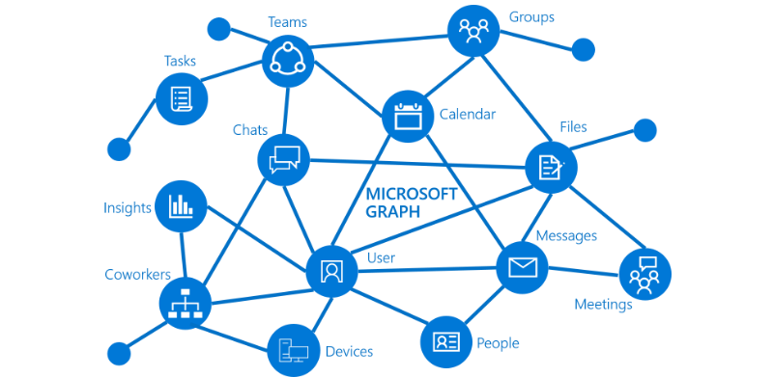


Technologies
Azure Automation
Power Automate
PnP Provisioning Engine
PnP Modern Search
Logic Apps
Azure Function
SharePoint Designer Workflow
Graph API
Azure WebJob

Slide 24
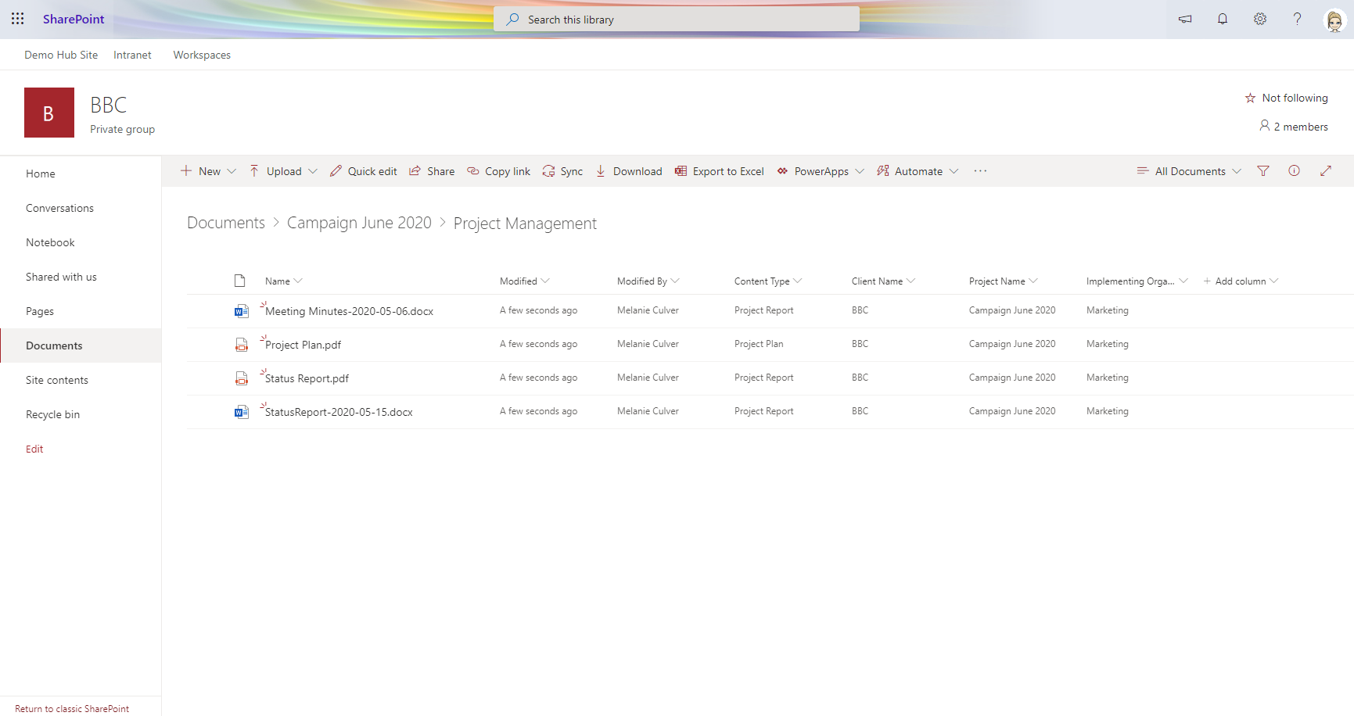
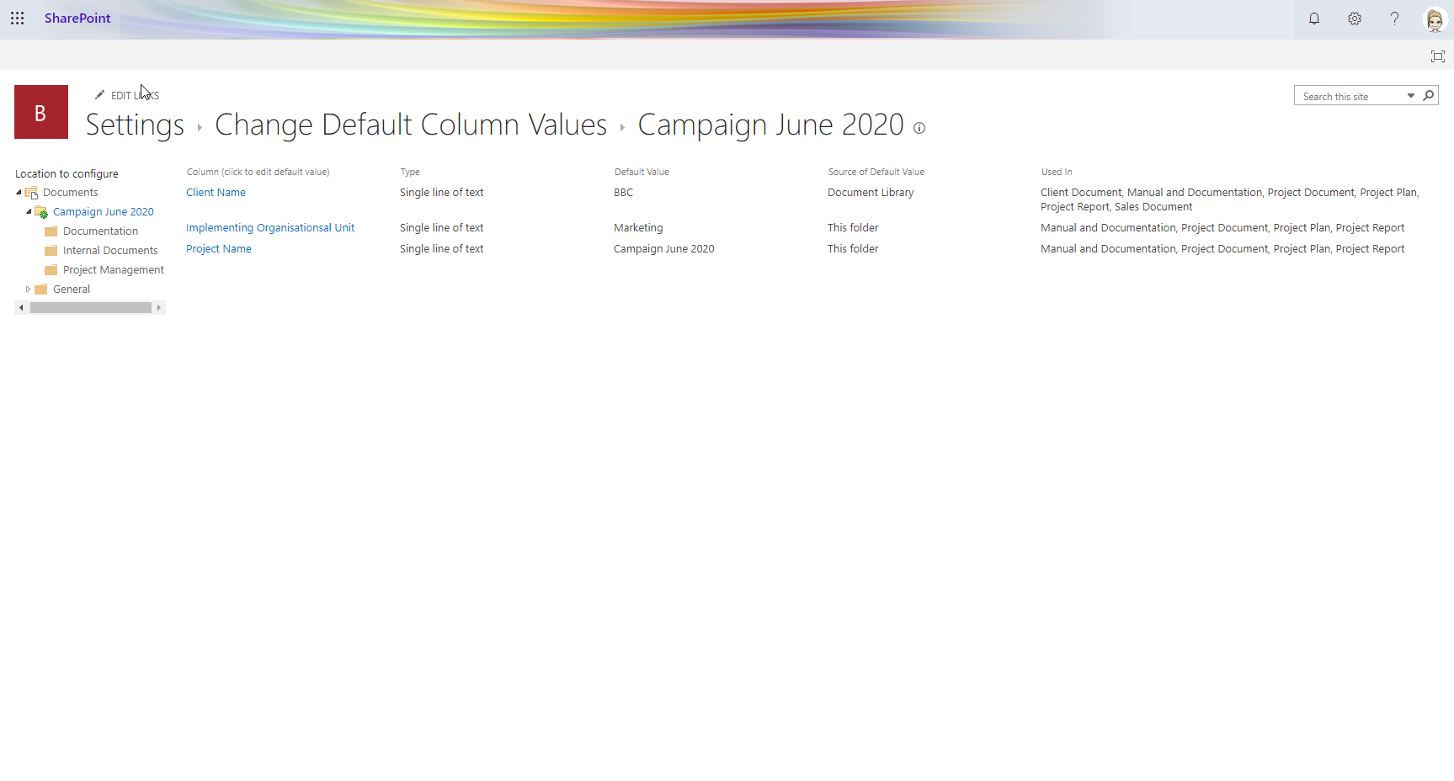
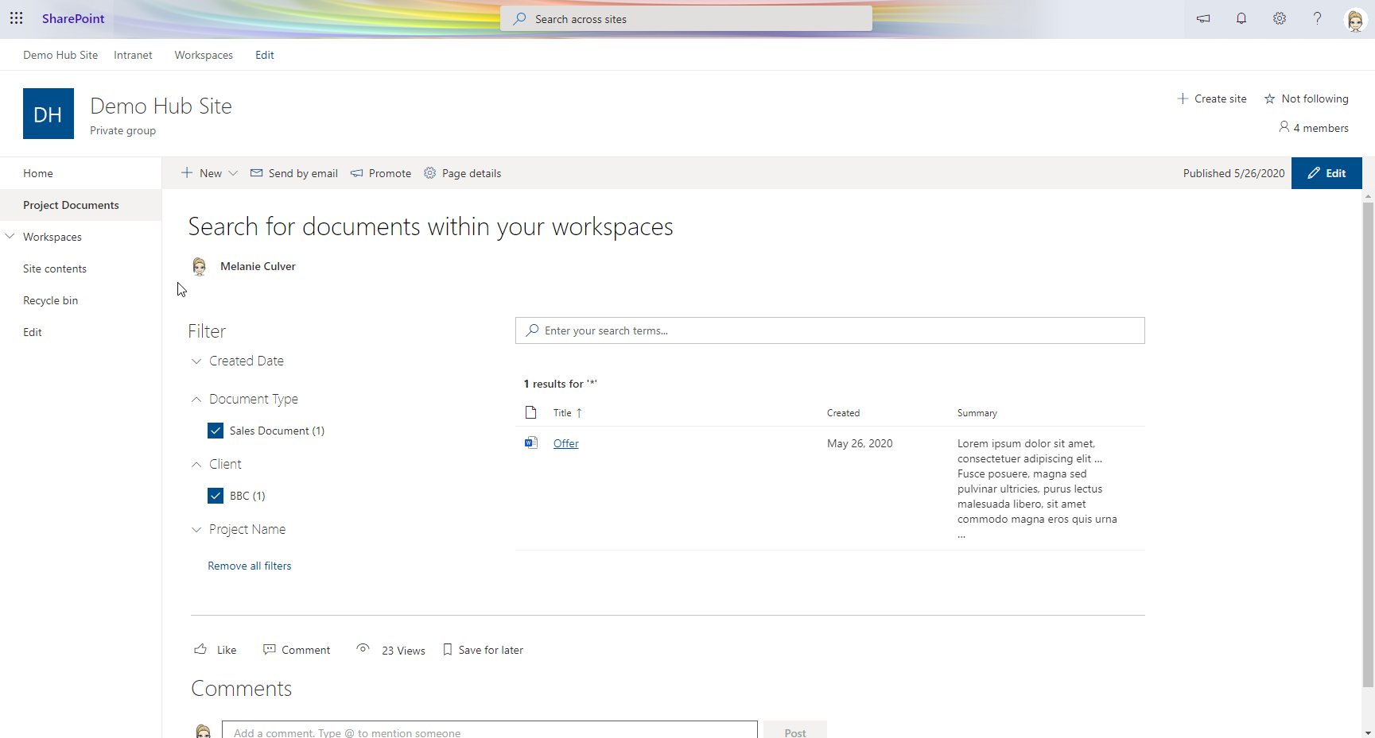
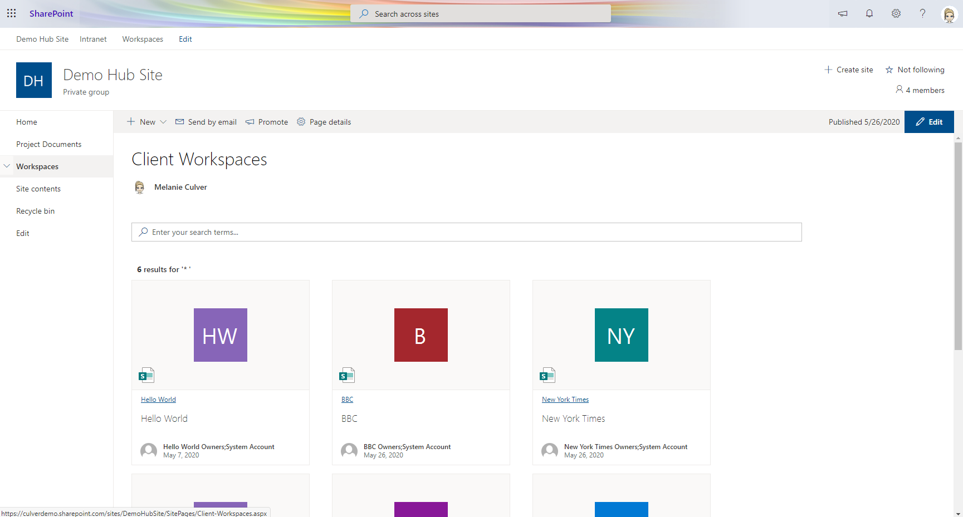

Slide 25
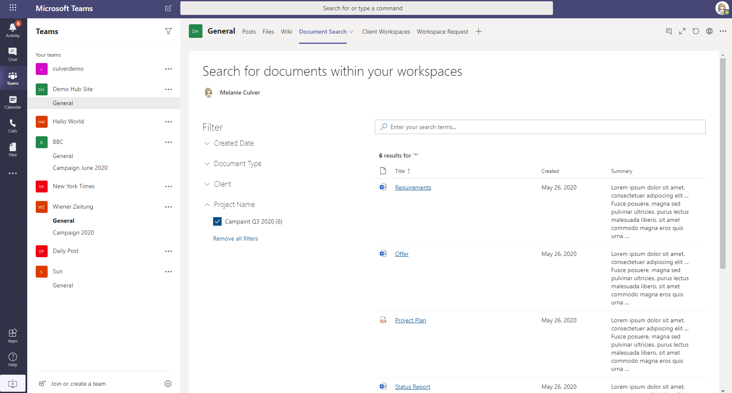
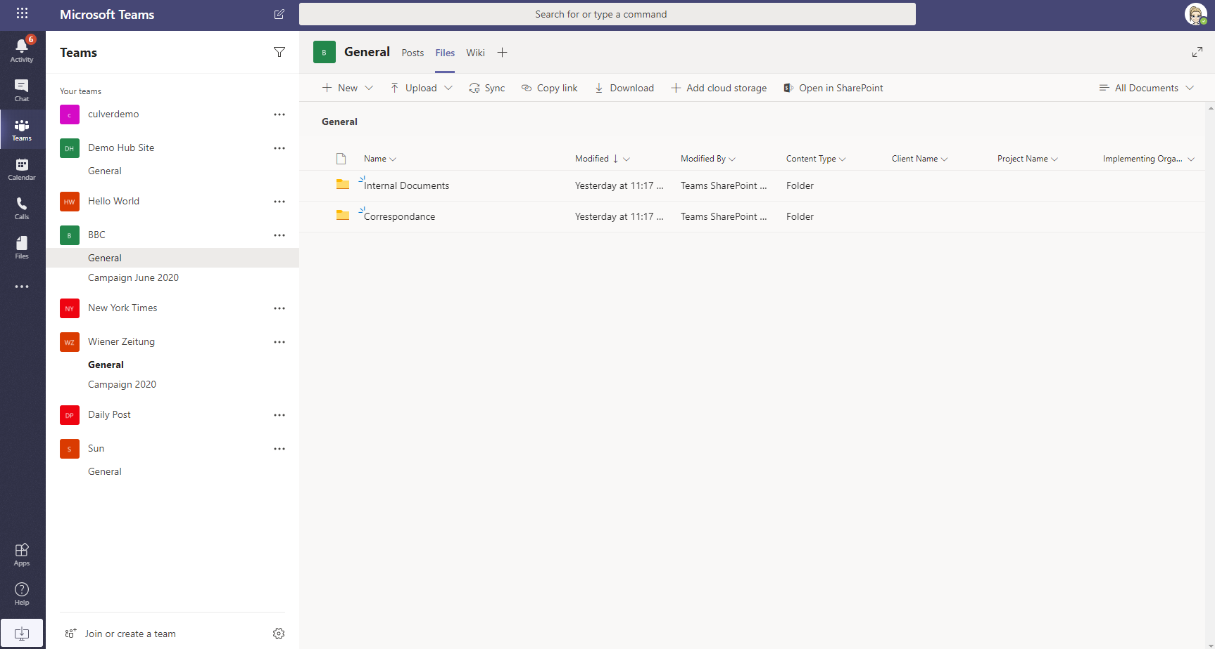
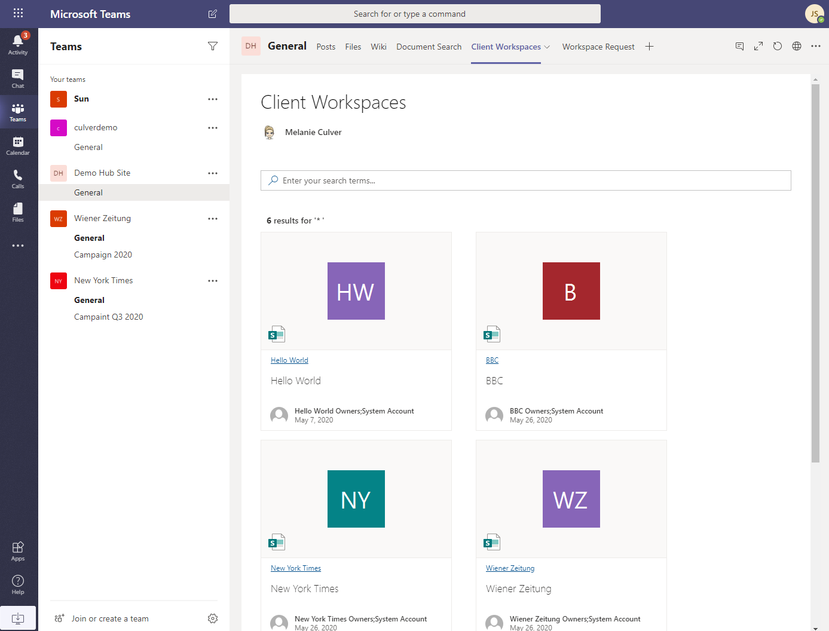

Slide 26
Demo

Slide 27
Recap of Demo
Workflow for Workspaces and Projects
Logic App for processing
Azure Functions for Provisioning
Azure Function for enforcing Teams/SharePoint Policies

Slide 28
Security
Authentication and Authorisation
AAD App with Graph API
Office CLI
Service Account
SharePoint App

Slide 29
Quick Wins
Find a business case & create search pages
Set default meta data
Use Teams Tabs to pin pages & docs
Hide and archive Teams
Forward emails with attachments
Create a single point of access
Standardise your Channels and Libraries
Create Hub Sites
Create PowerBI Reports based on search
Take a look at Project Cortex
….

Slide 30
Final Thoughts
Implement quick wins
Let users work where they feel comfortable
Teams, SharePoint and “File System” are ok!
Do really need to migrate everything? or at least create an “archive”
Train your users to use Office tools efficiently

Slide 31
Code
https://github.com/culvermelanie/Teams-SharePoint-Document-Management

Slide 32
Thank You
Any Questions ?
Let’s Connect: https://at.linkedin.com/in/culvermelanie

